Slide 1
H2MU
LPL Joson
Hannah Chua

Slide 2
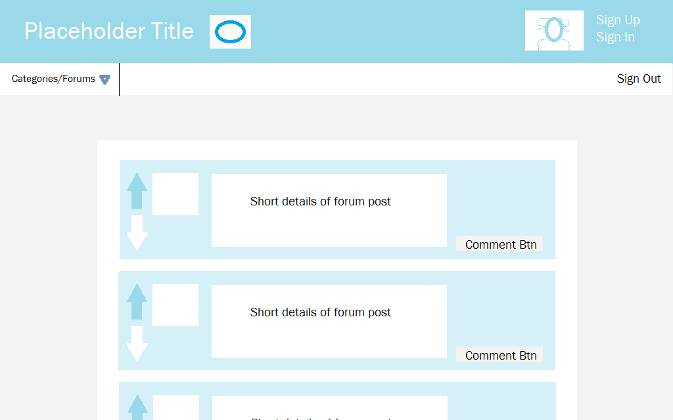
Landing Page

Slide 3
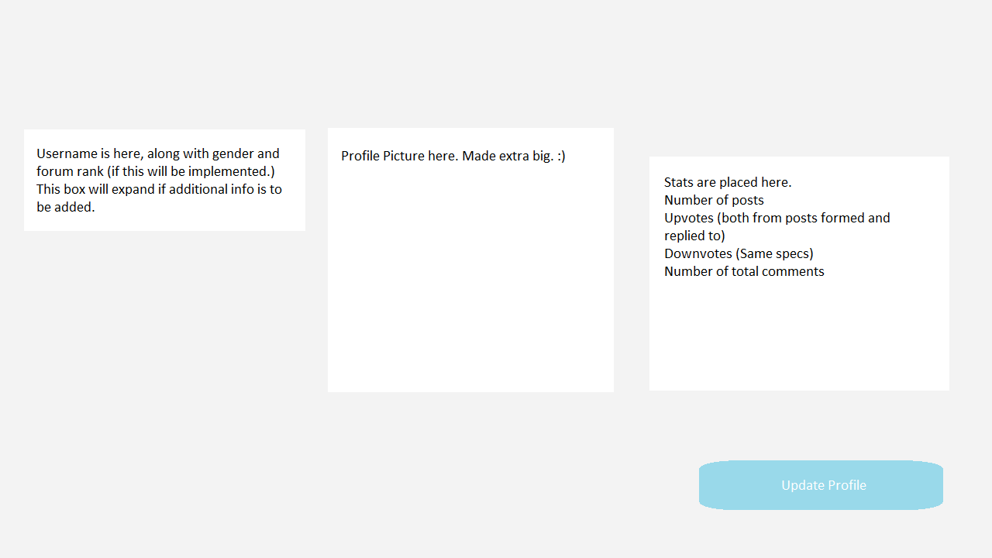
Profile Page
Notes:
This, and the update profile will have the same blue bar as the landing page in the final design

Slide 4
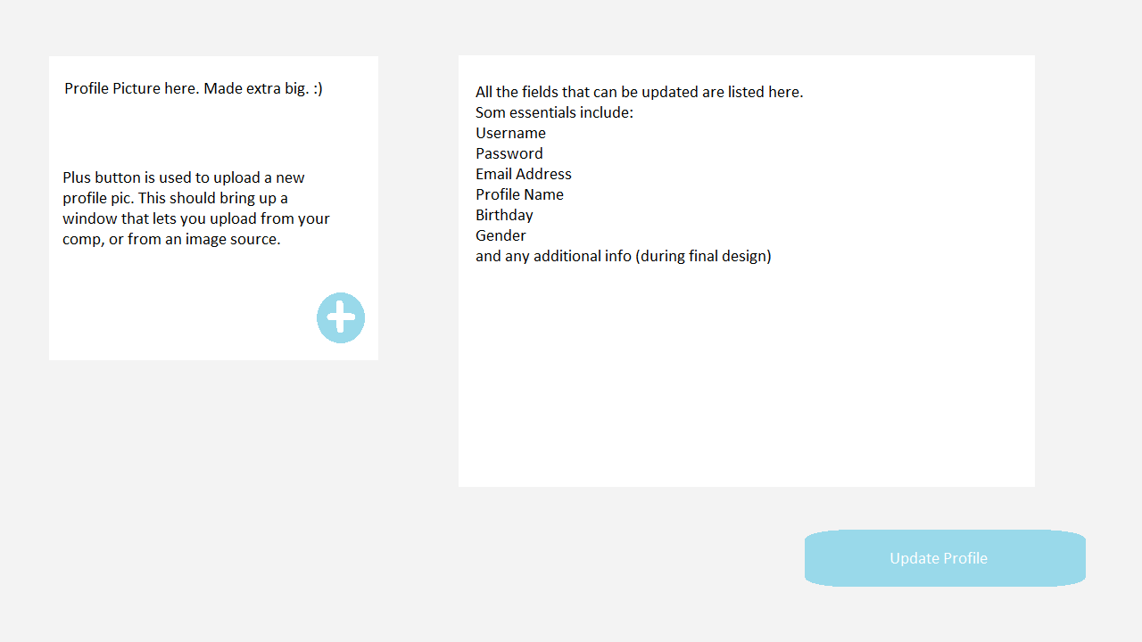
Update Profile Page

Slide 5
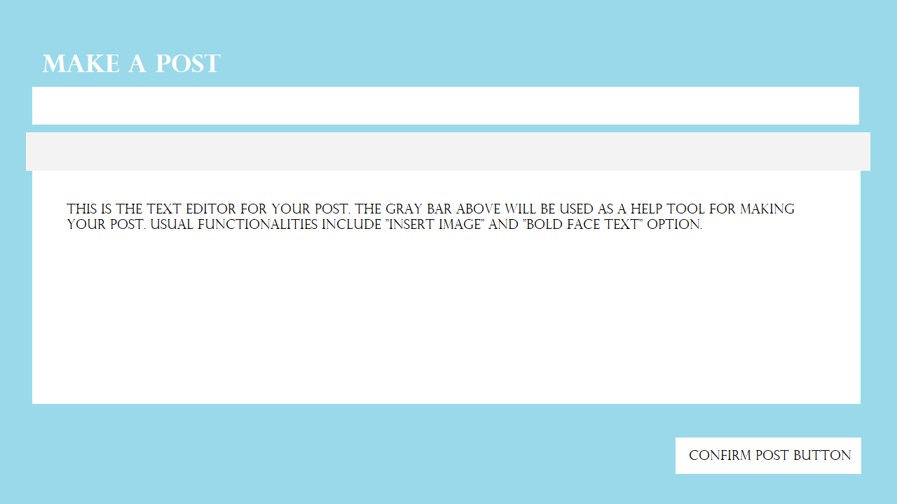
Make a post

Slide 6
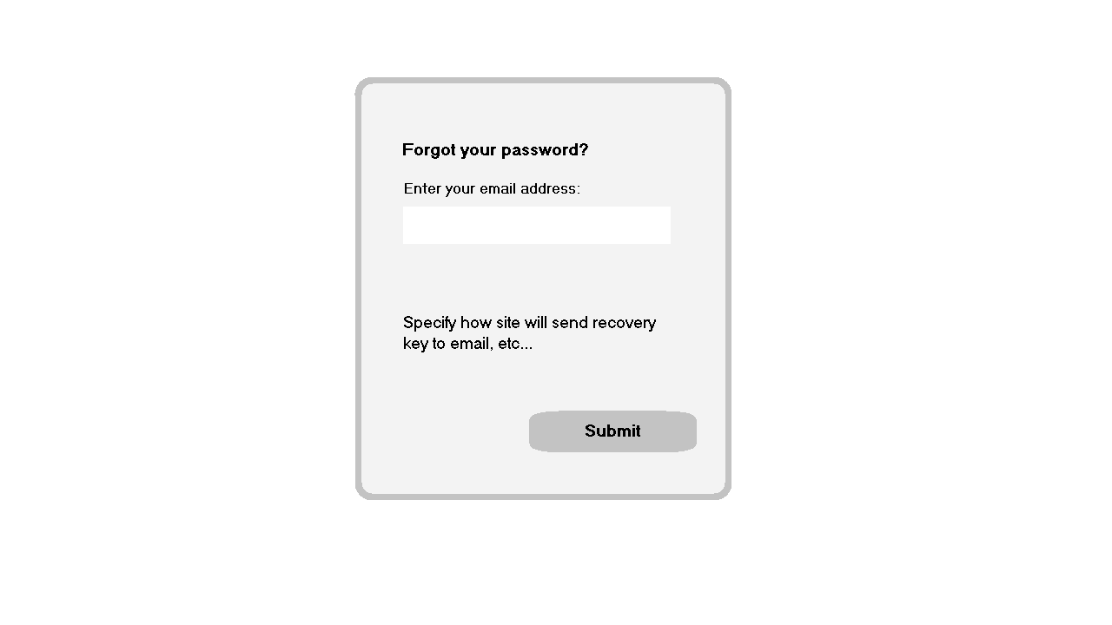
Forgot Password

